Slide 1
INTEL UNNATI INDUSTRIAL TRAINING PROGRAM
Project Report Kalpana N N-BU22CSEN0102309
G Moukthika Sri Srujana-BU22CSEN0102316
Notes:
1

Slide 2
Agenda
Introduction
Problem Definition
Objective
Solution overview
Model Architecture
Methodology
Technical Implementation
Results
Advantages
Limitations
Conclusion

Slide 3
INTEL
FOUNDED: July 18, 1968
FOUNDERS: Gordon Moore and Robert Noyce
HEADQUARTERS: Santa Clara, California, USA
INDUSTRY: Semiconductors, Computing, Artificial Intelligence
CEO: Pat Gelsinger
INTEL UNNATI PROGRAM
Intel Unnati is an initiative by Intel India aimed at fostering innovation and research among students and educators. The program provides access to the latest technology and resources, encouraging skill development in fields like AI, machine learning, IoT, and robotics.

Slide 4
Introduction
As networks grow in scale and complexity, securing them has become one of the biggest challenges for enterprises and service providers. Traditional security systems, heavily reliant on rule-based approaches and deep packet inspection (DPI), are now insufficient in handling:
Encrypted traffic (TLS, SSL)
Sophisticated cyberattacks (DDoS, malware, APTs)
High-speed, high-volume traffic environments
This project introduces an AI/ML-powered system capable of performing real-time network traffic analysis, detecting anomalies, and classifying encrypted and unencrypted traffic without violating user privacy.

Slide 5
Problem Definition
Objective
To design and implement an intelligent system that:
Automatically classifies network traffic by application or behavior.
Detects anomalies and potential threats like malware and port scanning.
Supports encrypted traffic analysis without needing decryption.
Scales efficiently for high-speed networks while maintaining low latency.

Slide 6
CHALLENGES WITH CURRENT NETWORK SECURITY SOLUTIONS:
Ineffective for Encrypted Traffic: Traditional DPI fails to analyze encrypted flows, creating blind spots in security.
High False Positives/Negatives: Rule-based systems often misclassify benign behavior as threats and miss zero-day attacks.
Scalability Issues: Existing solutions struggle to handle high-volume, high-speed networks.Delayed Detection: Manual analysis leads to slower threat response times.

Slide 7
We developed an AI/ML-based network security system that leverages flow-based traffic features to detect and classify network activity in real-time.
Key features:
✔ Real-time classification of traffic types (e.g., HTTP, SSH, DNS, unknown)
✔ Detection of anomalies including encrypted attacks
✔ Visual dashboard for live monitoring and alerts
Solution
overview

Slide 8
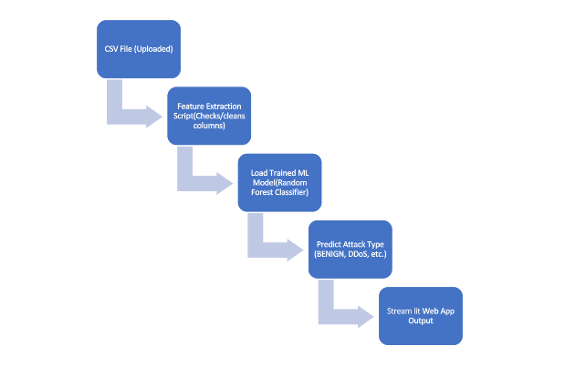
Model Architecture

Slide 9
Methodology
This project’s model methodology follows a stepwise process to detect and classify network traffic:
Step 1: Input Data Upload
CSV files containing network flow data are uploaded to the system.
Step 2: Feature Extraction
A preprocessing script checks the dataset for required columns.
Missing or irrelevant features are cleaned or filled with defaults to ensure smooth processing.
Step 3: Load Trained ML Model
A pre-trained Random Forest classifier is loaded into memory for prediction.
Step 4: Traffic Prediction
The model predicts the type of traffic for each row in the dataset, labeling flows as BENIGN, DDoS, PortScan, etc.
Step 5: Output Visualization
Results are displayed through a web application (Streamlit), showing traffic types and attack counts in real time.

Slide 10
Data Collection: Used public datasets like CIC-IDS2017 and live packet captures (via Wireshark/tcpdump). Collected metadata such as packet size, flow duration, protocol types, etc. Feature Engineering: Extracted features: Average packet size Bytes transferred per flow Inter-arrival time of packets Flow entropy (useful for encrypted traffic)
Technical Implementation

Slide 11
.
Model Development:
Random Forest and Support Vector Machine (SVM) for initial classification.
Tested Deep Learning (CNN) for improved accuracy on encrypted flows.
Real-Time Threat Detection:
Deployed the trained model on a Linux server to monitor live traffic.
Triggered alerts for suspicious or unknown behavior.
Visualization:
Built a Python Flask-based dashboard displaying:
Traffic types
Detected anomalies
Bandwidth usage trends

Slide 12
RESULTS & DISCUSSION
Dataset 1: Tuesday-WorkingHours.pcap_ISCX.csv
Large real-world dataset (128MB) from CICIDS2017.
Only 1/9 required features present → system filled missing values with defaults.
Result: All rows predicted as BENIGN (due to missing critical features).
Observation: Highlights importance of complete feature data for accuracy.
Dataset 2: sample_attack_data.csv
Small test file with 5/9 features present.
Result: Detected DDoS (4), PortScan (3), BENIGN (3).
Observation: Model successfully classified attacks when data was clean and sufficient.

Slide 13
Advantages
Handles Encrypted Traffic:
Uses flow-level metadata and statistical features for analysis.
No need to decrypt packets, ensuring user privacy and GDPR compliance.
Adaptive Defense:
ML models can dynamically learn from new traffic patterns and emerging threats.
Supports retraining with updated datasets for zero-day attacks.
Highly Scalable:
Optimized to handle high-speed enterprise networks (up to Gbps throughput).
Can be deployed in cloud, edge, or hybrid environments for flexibility.

Slide 14
Low False Alarms:
Advanced feature engineering reduces false positives and negatives.
Allows SOC teams to focus on real threats without alert fatigue.
Real-Time Monitoring:
Achieves latency of ~700ms per flow, enabling quick detection and response.
Cost-Effective Solution:
Eliminates need for expensive DPI hardware appliances.
Can run on standard Intel CPUs without GPU acceleration.

Slide 15
Limitations
High Computational Requirements:
Deep learning models require significant CPU/GPU resources for large-scale deployments.
Periodic Retraining Needed:
Models need regular updates with new labeled data to stay effective against evolving threats.
Dataset Dependency:
System performance depends on the quality and completeness of input datasets (missing features can affect accuracy).
Initial Processing Latency:
First-time processing of very large datasets may take longer due to feature extraction overhead.

Slide 16
Conclusion
The developed AI/ML-powered system demonstrates a robust, scalable, and privacy-preserving approach to network traffic analysis and threat detection. It moves beyond static, signature-based systems to provide real-time insights and defense against modern cyberattacks.
This project proves the potential of AI/ML as a critical enabler in next-generation network security frameworks.

Slide 17
THANK YOU

